Slide 1
Dénes Csala
PhD Defense
Masdar Institute | 12/05/16
A data-driven dynamic net-energy analysis of global and national sustainable energy transition paths

Slide 2
A data-driven dynamic net-energy analysis of global and national sustainable energy transition paths
Notes:
Wealthy countries could afford to do that because of fossil fuels. 2 problems with that. Depletion and global warming.

Slide 3

outline
objective
definition & methodology
background
conclusions future work
regional results
global results

Slide 4
outline
objective
definition & methodology
background
conclusions future work
regional results
global results

Slide 5
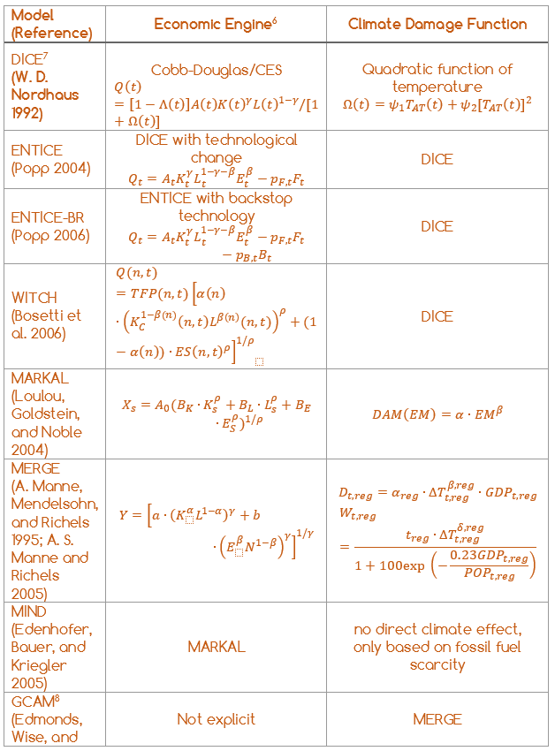
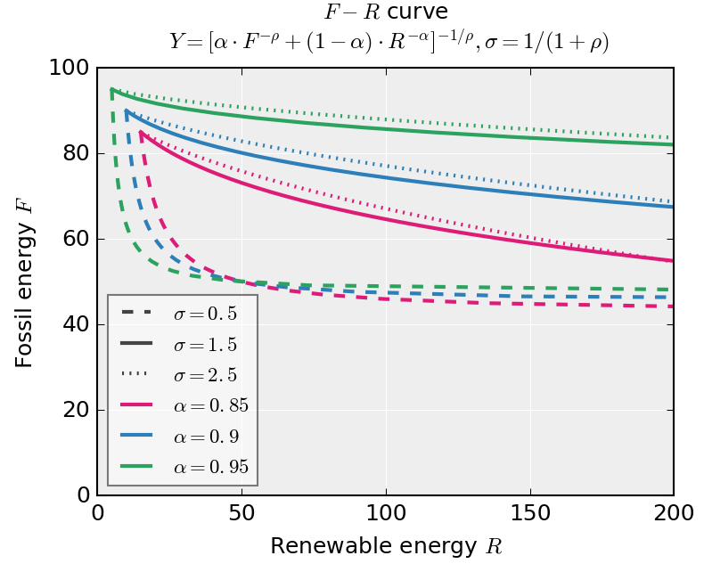
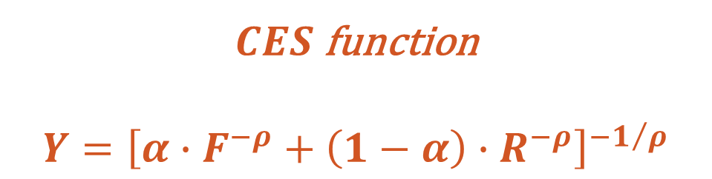
IAMs
Integrated assessment models (IAM) are climate economy models that are widely used for tying the evolution of the climate system to the economic system.
$CES$ function
$$Y={\left[α∙F^{−ρ}+\left(1−α\right)∙R^{−ρ}\right]}^{−1/ρ}$$
Arrow, Chenery, Minhas, Solow (1961), Sgouridis, Kaya, Csala (2016, under review)
Notes:
To begin with, in most IAMs, economic output is assumed to be growing at an exogenous background rate.
2.3%
China vs us consumption in 2010
CDFs are usually presented as a percentage of the GDP that is “lost” to climate impacts but in most cases this loss does not impact the GDP background growth rate. - 10% loss in global economy at 8degrees

Slide 6
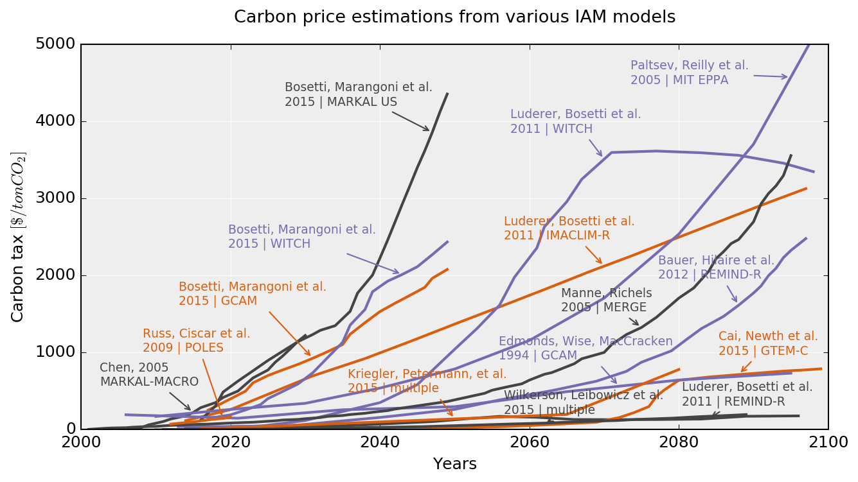
carbon price
countries should deploy measures with a marginal cost that is equal to the global marginal benefit from avoiding climate change
(Aldy, Barrett, and Stavins 2003), Sgouridis, Kaya, Csala (2016, under review)
Notes:
-Individual countries though have the incentive to simply reach their own marginal benefits
-hunger crisis forest firest, let alone sea level rise

Slide 7
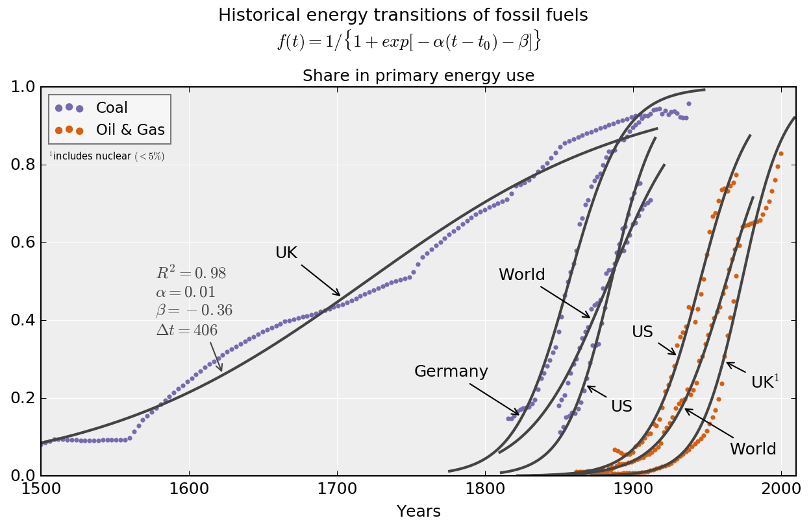
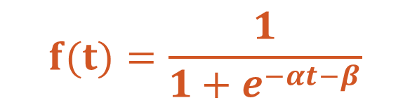
past transitions
CES cannot model technology transitions accurately
Energy transitions of the past followed a logistic curve
$$f(t)=\frac{1}{1+e^{−αt−β}}$$
Sgouridis, Kaya, Csala (2016, under review) – based on Grubler (2012), Fouquet (2010), O’Connor (2010)
Notes:
On top of maximizing GDP as the equivalent of social welfare, IAM’s are also very uncertain

Slide 8
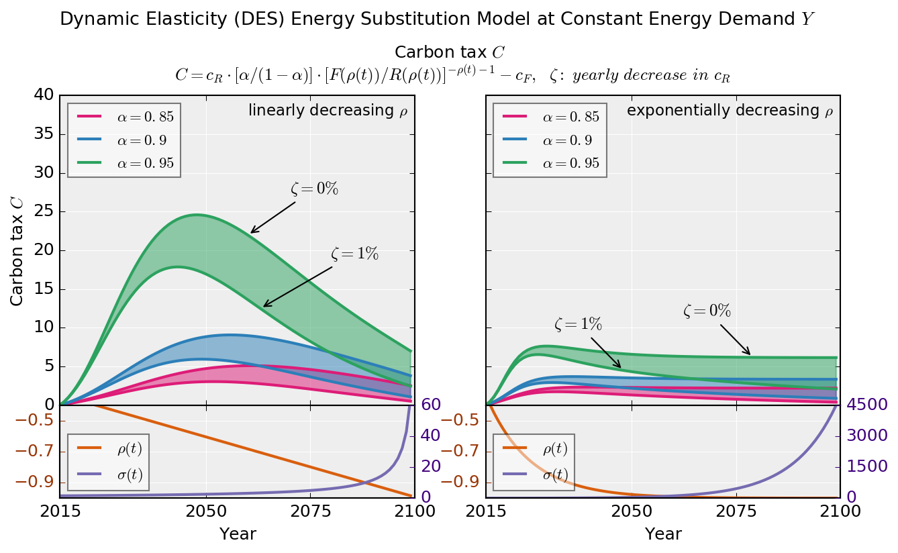
dynamic elasticity of substitution
Aritificially change the elasticity over time
Challenging to connect to physical realities and still sensitive
Sgouridis, Kaya, Csala (2016, under review)
Notes:
On top of maximizing GDP as the equivalent of social welfare, IAM’s are also very uncertain

Slide 9
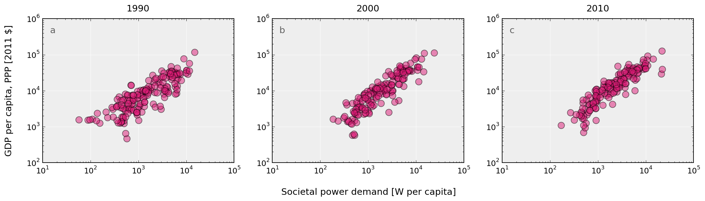
societal power demand
Own work based on open energy and GDP data from World Bank (1990-2010)
Notes:
On top of maximizing GDP as the equivalent of social welfare, IAM’s are also very uncertain

Slide 10
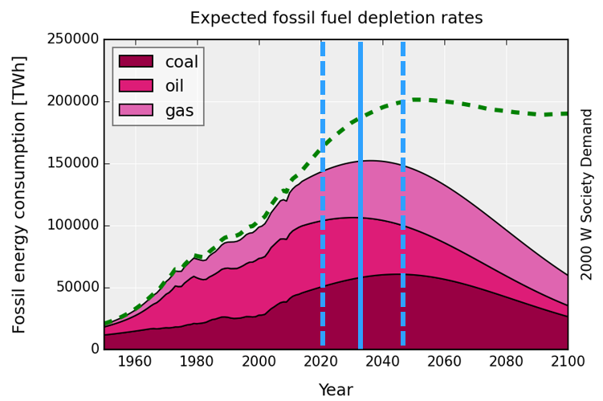
IPCC AR5 WG1 RCP2.6
Carbon budget*
990 GtCO₂
[510 – 1505]
2032
[2020-2045]
GRAPH: Own work based on open energy data from EIA (1970-2040), BP (1960-2035), population data from UNSD, (1950-2100)
Maggio, Cacciola (2012), Mohr et al. (2015)
* Fossil fuels, industrial processes (including cement) and waste
Notes:
Wealthy countries could afford to do that because of fossil fuels. 2 problems with that. Depletion and global warming.
Potential reserves exceed the co budget by 35-60 times (6-7 proven reserves)

Slide 11
research objective
This research aims to define the concept of a sustainable energy transition based on energy stocks and flows then develop a global and a full list of globally coordinated, national sustainable energy transitions paths that collectively meet the planetary emissions constraints and minimize the collective energy expenditure while doing so.
Notes:
Wealthy countries could afford to do that because of fossil fuels. 2 problems with that. Depletion and global warming.

Slide 12
research questions
What is the feasibility of a global sustainable energy transition?
If possible, what level of economic and social effort is necessary to achieve it?
(transition scale, timeline, options, trade-offs)
b. What is the evolution of the energy investment rate to complete the transition?
What are the feasibilities of sustainable energy transitions for individual nations?
If possible how is the national sustainable energy transition affected by:
Natural energy resources (fossil reserves and renewable potential)
Trade and intermittency of renewables
Notes:
Wealthy countries could afford to do that because of fossil fuels. 2 problems with that. Depletion and global warming.

Slide 13
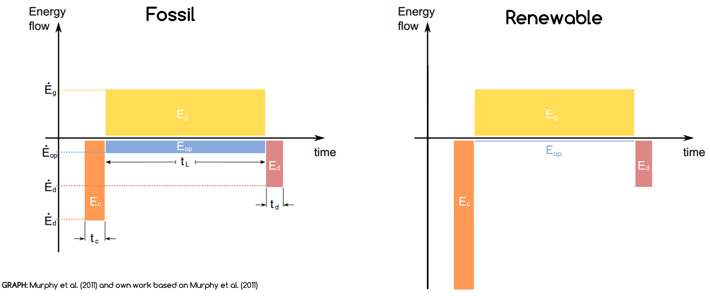

OPEX vs. CAPEX nature of energy investment
$EROEI=\frac{E_{g}}{E_{c}+E_{op}+E_{d}}$=$\frac{\int_{t_{0}}^{t}{{\dot{E}}_{g}}dt}{E_{c}+−\int_{t_{0}}^{t}{{\dot{E}}_{op}}dt+E_{d}}$
Murphy et al. (2011) and own work based on Murphy et al. (2011)
Notes:
Wealthy countries could afford to do that because of fossil fuels. 2 problems with that. Depletion and global warming.

Slide 14
sustainable energy transition
The impacts from energy use during SET should not exceed the long-run ecosystem carrying and assimilation capacity.
Per capita net available energy should remain above a level that satisfies societal needs at any point during SET and without disruptive discontinuities in its rate of change.
The rate of investment in building renewable energy harvesting and utilization capital stock should be sufficient to create a sustainable energy supply basis before the non-renewable safely recoverable resources are exhausted.
Daly (1996), Sgouridis, Csala (2014), Sgouridis, Bardi, Csala (2016, under review)
Notes:
Environment, equity, economy

Slide 15
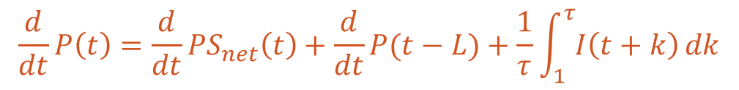
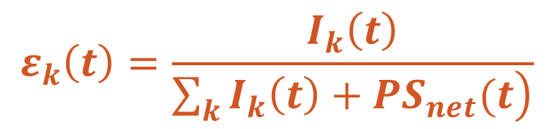
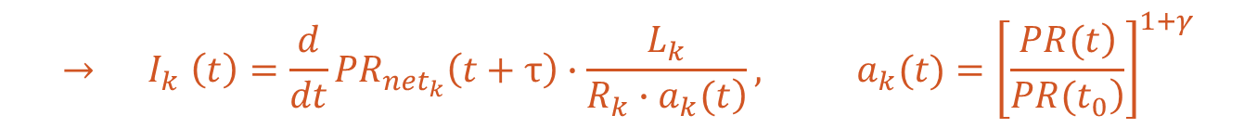
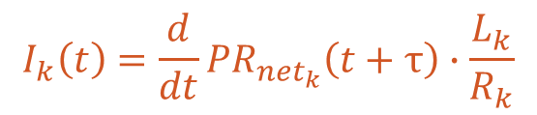
sustainable energy transition
$$\frac{d}{dt}P\left(t\right)=\frac{d}{dt}{PS}_{net}\left(t\right)+\frac{d}{dt}P(t−L)+\frac{1}{τ}\int_{1}^{τ}{I\left(t+k\right)}dk$$
$$\frac{d}{dt}{PR}_{net}\left(t\right)=\frac{d}{dt}\left\{{PS}_{net}\left(t\right)−\left[\left.{PF}_{net}\left(t\right)+{PX}_{net}(t\right)\right]\right\}+\frac{d}{dt}{PR}_{net}\left(t−L\right)$$
$$I_{k}\left(t\right)=\frac{d}{dt}{PR}_{{net}_{k}}\left(t+τ\right)∙\frac{L_{k}}{R_{k}}$$
$${→ I}_{k}\left(t\right)=\frac{d}{dt}{PR}_{{net}_{k}}\left(t+τ\right)∙\frac{L_{k}}{\left.R_{k}∙a_{k}(t\right)}, a_{k}(t)={\left[\frac{\left.PR(t\right)}{\left.PR(t_{0}\right)}\right]}^{1+γ}$$
$$ε_{k}\left(t\right)=\frac{I_{k}\left(t\right)}{\left.\sum_{k}{I_{k}\left(t\right)}+{PS}_{net}(t\right)}$$
renewable energy investment ratio
Sgouridis, Csala (2014)
Notes:
Wealthy countries could afford to do that because of fossil fuels. 2 problems with that. Depletion and global warming.

Slide 16
modeling
Trade
data
[UN COMTRADE]
Renewable
EROEI
[Literature]
Sustainable Energy Transition Paths
Population projections
[UNSD]
Renewable energy data
Transition Feasibility Index
Demand data
Demand projections
[Literature]
Most Feasible Paths
Fossil
data
Renewable potential
[NREL]
Emissions data
[IPCC, EIA, BP]
An automated creation of feasible sustainable
energy transition paths for the globe and all nations

Slide 17
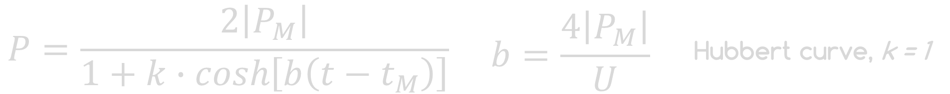
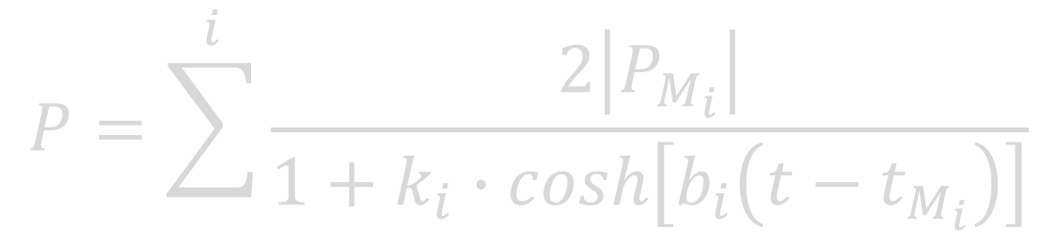

global SET modeling
$P_{M}$ - peak production, $t_{M}$ - peak year, $U$ – ultimately recoverable reserves
Forced Hubbert phase-out
Demand projections
[Literature]
Hubbert curve multi-variant
Fossil
data
Emissions data
[IPCC, EIA, BP]
$$P_{M},t_{M}$$
well-defined
U limited by carbon cap!
Maggio, Cacciola (2012)
Notes:
Most of the modeling is being conducted by developing – mostly economically ratified scenarios – and then assessing the impact later.
We decided to go the other way around and investigate only the scenarios which fit into the co2 limit by design.

Slide 18



global SET modeling
$$I_{renewable}=\frac{d}{dt}C_{ren}+\frac{1}{c}\int_{t−L}^{t}{I_{renewable}}$$
Renewable
EROEI
[Literature]
Population projections
[UNSD]
Renewable energy data
Demand data
Demand projections
[Literature]
Fossil
data
Emissions data
[IPCC, EIA, BP]
Own work for Sgouridis, Bardi, Csala (under review)

Slide 19
global SET modeling
Trade
data
[UN COMTRADE]
Renewable
EROEI
[Literature]
Sustainable Energy Transition Paths
Population projections
[UNSD]
Renewable energy data
Demand data
Demand projections
[Literature]
Fossil
data
Renewable potential
[NREL]
Emissions data
[IPCC, EIA, BP]
Own work for Sgouridis, Bardi, Csala (under review)

Slide 20
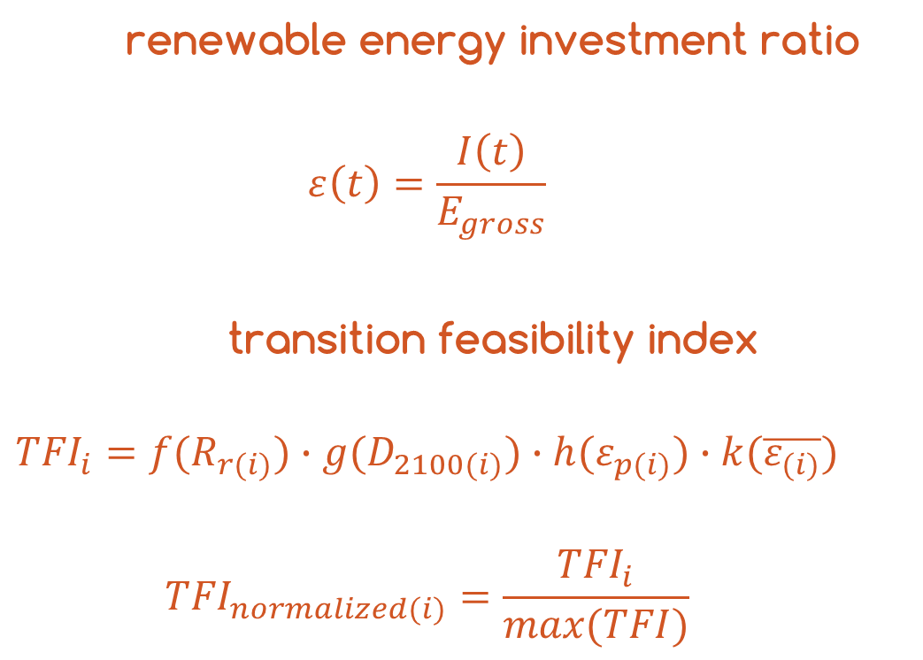
global SET modeling
Trade
data
[UN COMTRADE]
renewable energy investment ratio
$$ε\left(t\right)=\frac{I\left(t\right)}{E_{gross}}$$
transition feasibility index
$${TFI}_{i}=f(R_{r(i)})∙g(D_{2100(i)})∙h(ε_{p(i)})∙k(\overline{ε_{(i)}})$$
$${TFI}_{normalized(i)}=\frac{{TFI}_{i}}{max⁡(TFI)}$$
Sustainable Energy Transition Paths
Renewable energy data
Transition Feasibility Index
Most Feasible Paths
Renewable potential
[IRENA]
Own work for Sgouridis, Bardi, Csala (2016, under review)

Slide 21
regional SET modeling
Historical trade data
[UN COMTRADE]
Renewable
EROEI
[Literature]
Sustainable Energy Transition Paths
Population projections
[UNSD]
Renewable energy data
Stochastic resource matching
Transition Feasibility Index
Demand data
Demand projections
[Literature]
Dynamic trade network
Most Feasible Paths
Fossil
data
Renewable potential
[NREL]
Emissions data
[IPCC, EIA, BP]
regional cost matrix

Slide 22
regional SET modeling
primary secondary
A Plan to Power 100 Percent of the Planet with Renewables (Scientific American, 2009)
Providing all global energy with wind, water, and solar power: Technologies, energy resources, quantities and areas of infrastructure, and materials (2 articles, Energy Policy, 2010)
Review of solutions to global warming, air pollution, and energy security (RSC Energy & Env. Science, 2008)
Jacobson
Delucchi
emissions distribution
Raupach, Davis, Peters
Davis, Caldeira
McGlade, Ekins
Sharing a quota on cumulative carbon emissions (Nature Climate Change, 2014)
Consumption-based accounting of CO2 emissions (PNAS, 2009)
The geographical distribution of fossil fuels unused when limiting global warming to 2 °C (Nature, 2015)
system integration
Representing power sector variability and the integration of variable renewables in long-term energy-economy models using residual load duration curves (Energy, 2015)
Global energy storage demand for a 100% renewable electricity supply (Energy Procedia, 2014)
Many conference papers on supergrids and storage
Luderer, Ueckert
Breyer, Bogdanov
Notes:
Emission distribution: laissez-fair, or quotas, based on consumption or production
Even higher granularity than national

Slide 23
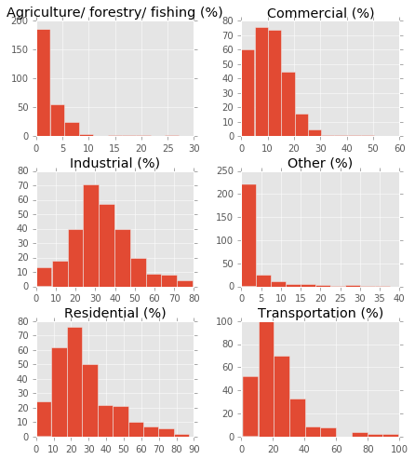
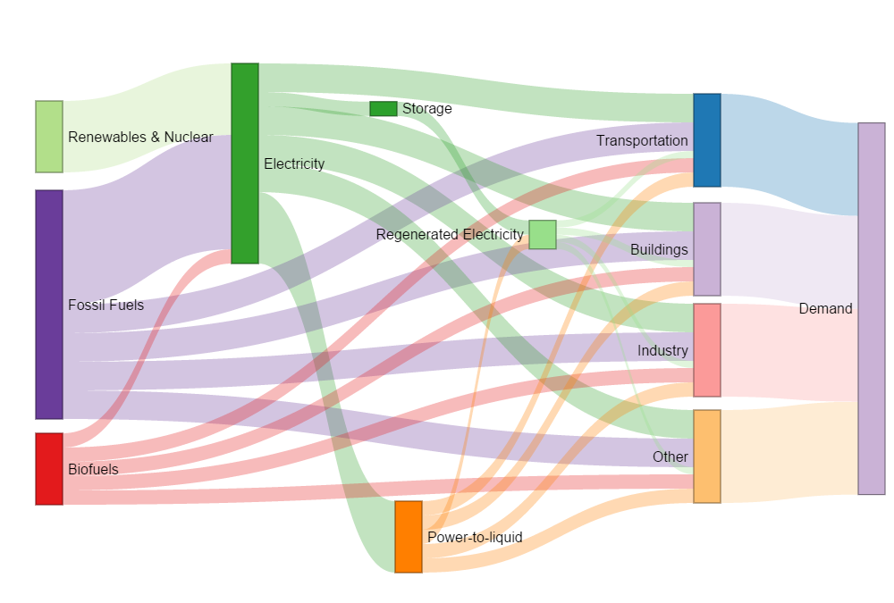
trade network modeling
Convert primary demand to secondary demand based on Jacobson (2016)
Data available from 100renewable.com for 139 countries, extrapolate the rest,
Typically in the range of 30% reduction overall
number of countries
percentage reduction in energy demand
Notes:
Wealthy countries could afford to do that because of fossil fuels. 2 problems with that. Depletion and global warming.

Slide 24
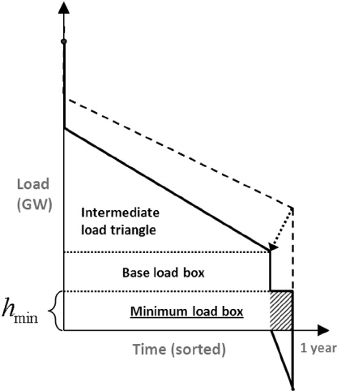
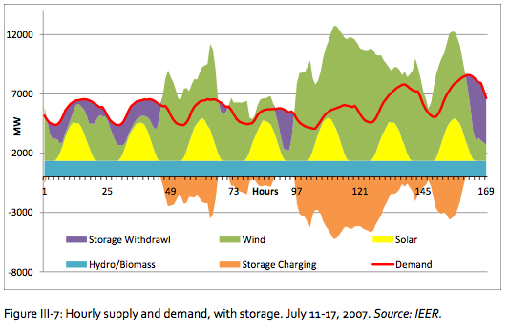
trade network modeling
estimation of storage needs from residual load duration curves
Ueckert et. al (2015), IEER (2012)
Notes:
Emission distribution: laissez-fair, or quotas, based on consumption or production
Even higher granularity than national

Slide 25
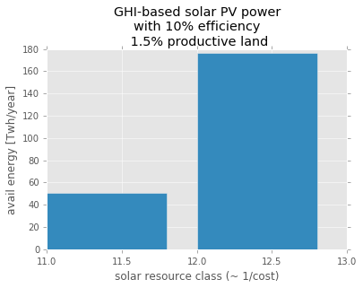
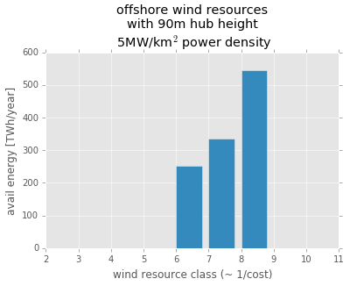
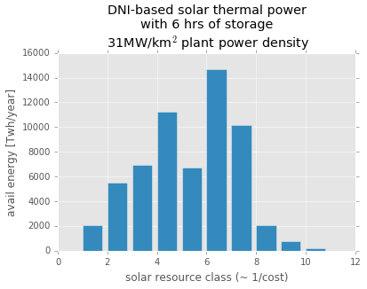
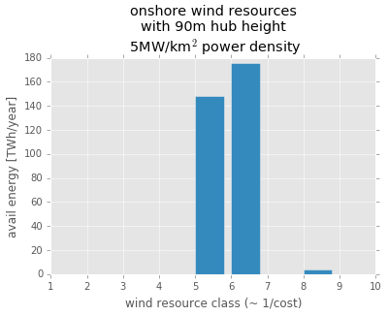
trade network modeling
Collect country insolation GIS data and create distributions of reserve quality (DNI, GHI, Wind Speed) from NREL data
Calculate binned energy production capacities with different capacity factors for different resource qualities
Create normalized energy cost matrix based on geometric distances and existing infrastructures
UAE
Denmark
solar resource class (~EROEI)
wind resource class (~EROEI)
US
Denmark
Own work based on data from NREL
solar resource class (~EROEI)
wind resource class (~EROEI)
Notes:
Wealthy countries could afford to do that because of fossil fuels. 2 problems with that. Depletion and global warming.

Slide 26
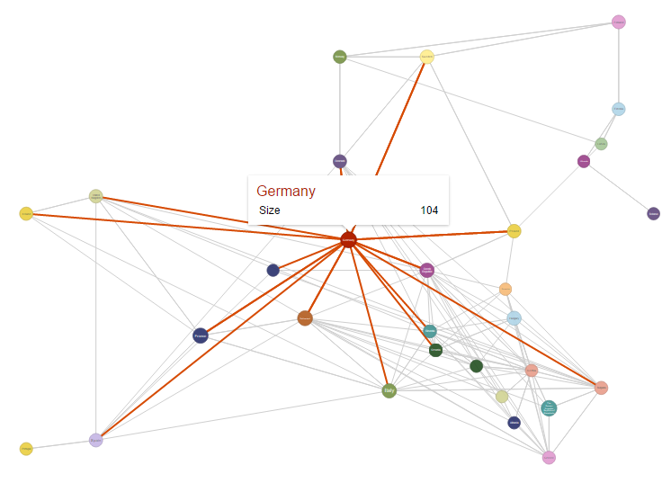
trade network modeling
Collect historical trade data on fossil fuels and electricity from the UN COMTRADE database
Collect historical price data from World Bank Commodities database
Create historical energy trade flow networks
2015 electricity trade network of Europe
Own work based on data from UN COMTRADE, and WDC
Notes:
Wealthy countries could afford to do that because of fossil fuels. 2 problems with that. Depletion and global warming.

Slide 27
trade network modeling
trade transaction cost = marginal resource cost x influence factor
$$cost\left(country,partner,fuel,value\right)=\frac{R\left(partner,value\right)}{average R}∙EROEI\left(fuel\right)∙$$
$$storage factor\left(fuel\right)∙transportfactor(country,parnter, fuel)$$
regional cost matrix
$$normal cost=\frac{cost}{average cost}$$
$$cost factor=\sqrt[w+z]{{\left(normal cost\right)}^{w}+{\left(influence\right)}^{z}}$$
relative importance = locally normalized trade volume to average trade flow
If A imports from B: country influence of B on A = weighted geometric mean of
= relative importance of country B in country A’s historical imports
x relative importance of country A in country B’s historical exports
country
influence
matrix
Notes:
Wealthy countries could afford to do that because of fossil fuels. 2 problems with that. Depletion and global warming.

Slide 28
resource allocation algorithm
Epoch
Epoch 1
Epoch 2
Converge
Year
Importers
Country
Random
Need
Cost factor
Need
Tier need
Partner
Diversification
Swap
Next Year
Swap
Next Country
Next Tier
generalized
assignment
problem
NP-hard
stochastic generalized assignment
(Hungarian algorithm)
with simulated annealing
Notes:
Wealthy countries could afford to do that because of fossil fuels. 2 problems with that. Depletion and global warming.

Slide 29
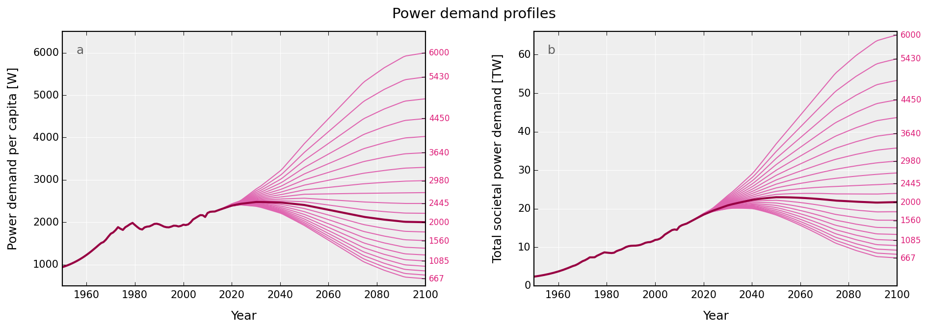
global sensitivity analysis
EROEI₂₀₁₄ range: 6.67 … 20 ... 60 Demand₂₁₀₀ range: 667 … 2000 ... 6000 [Wp/cap]
Notes:
Wealthy countries could afford to do that because of fossil fuels. 2 problems with that. Depletion and global warming.

Slide 30
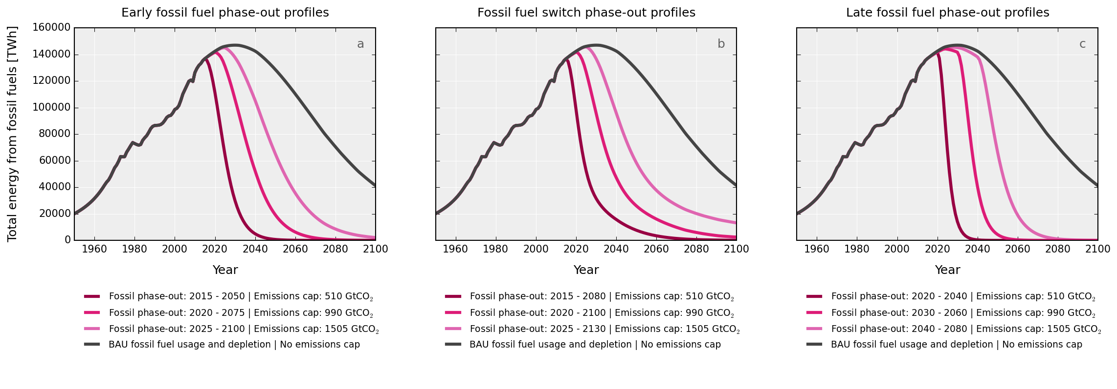
global sensitivity analysis
3 different carbon budgets: IPCC 2 degree (RCP2.6 low, median and high)
Notes:
Wealthy countries could afford to do that because of fossil fuels. 2 problems with that. Depletion and global warming.

Slide 31
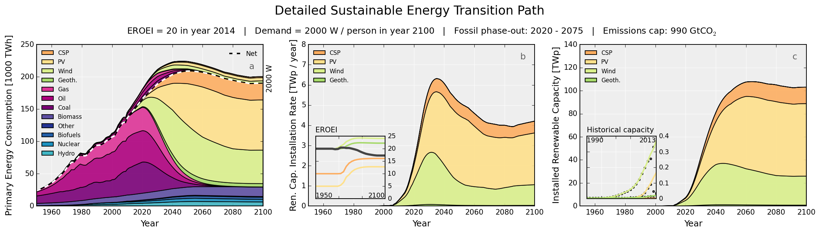
global results
Notes:
Wealthy countries could afford to do that because of fossil fuels. 2 problems with that. Depletion and global warming.

Slide 32
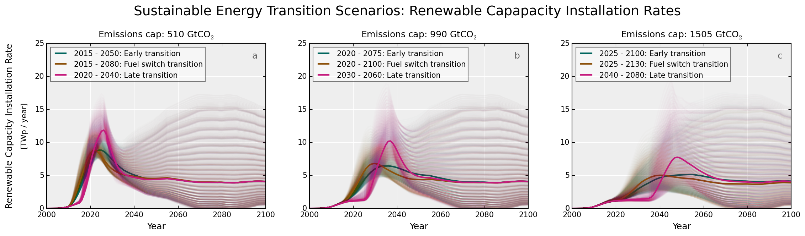
global results
Notes:
Wealthy countries could afford to do that because of fossil fuels. 2 problems with that. Depletion and global warming.

Slide 33
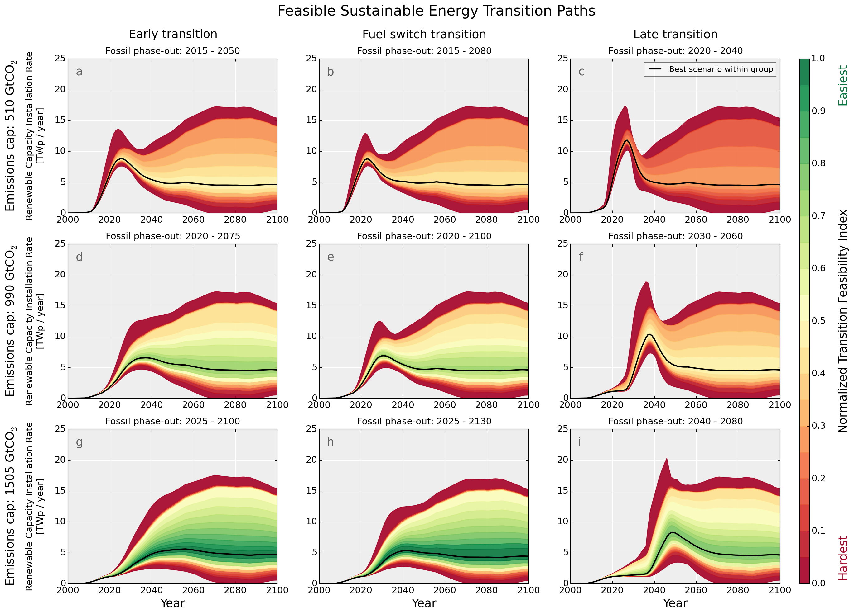
global sensitivity analysis
The transition envelopes are narrow during the early transition phase
Hitting the feasible region requires a 55 times increase in renewable energy installation rates within two decades
Notes:
Wealthy countries could afford to do that because of fossil fuels. 2 problems with that. Depletion and global warming.

Slide 34
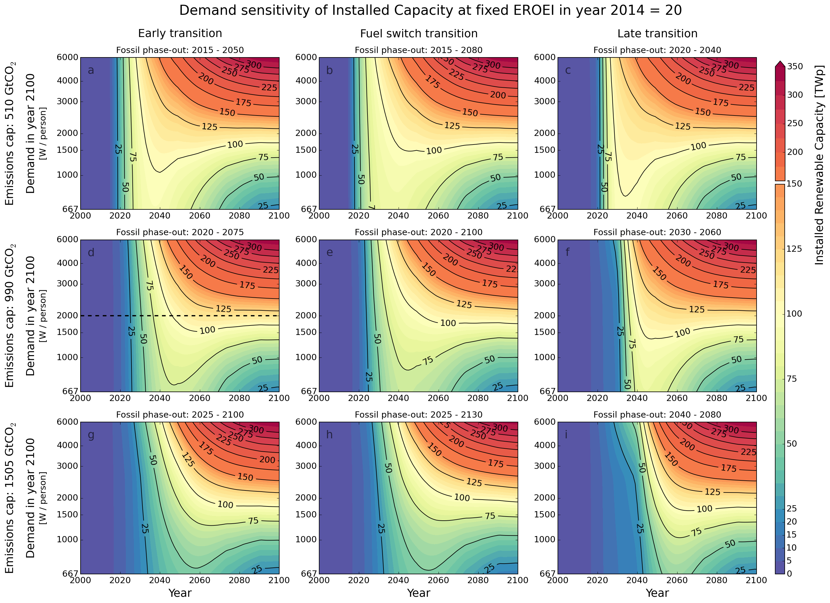
global sensitivity analysis
majority of additional capacity needs to be added before 2040
this holds even with very small final demand
transition speed critical
Notes:
Wealthy countries could afford to do that because of fossil fuels. 2 problems with that. Depletion and global warming.

Slide 35
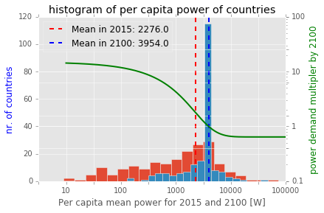
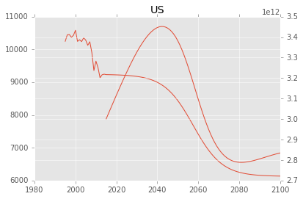
regional assumptions
Collect population projections of countries from UNSD database
Calculate historical per capita average power
Forecast per capita and total demand based on transfer function adapted from global SET
per capita avg power [W]
country energy demand [TWh]
year
Own work based on data from UNSD
Notes:
Wealthy countries could afford to do that because of fossil fuels. 2 problems with that. Depletion and global warming.

Slide 36
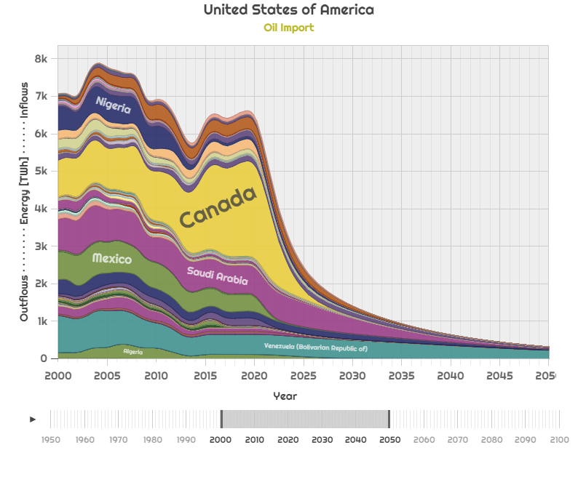
regional assumptions
Distribute the remaining fossil fuel budget across producers based on energy intensity per McGlade & Ekins (2015)
Calculate fossil fuel retraction curves, based on Hubbert
Distribute fossil exports of producers proportionally with the status quo, until depletion
Own work based on MacGalde, Ekins (2015), Maggio, Cacciola (2009) with data from UN COMTRADE, and WDC
Notes:
Wealthy countries could afford to do that because of fossil fuels. 2 problems with that. Depletion and global warming.

Slide 37
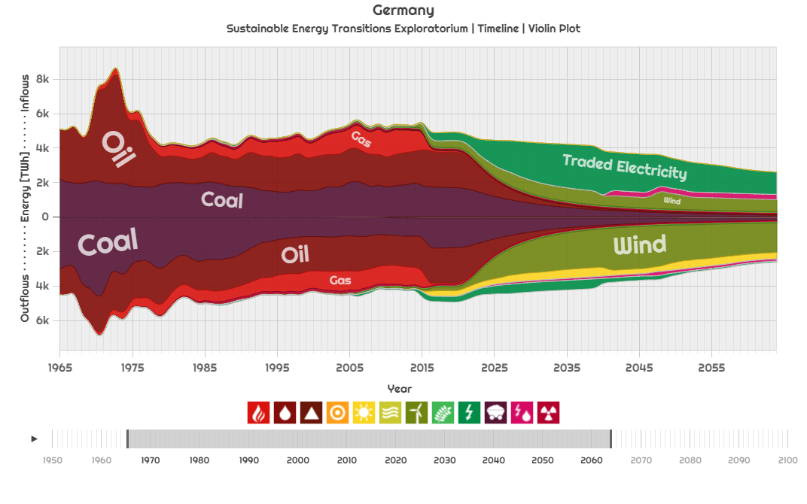
regional results
Notes:
Wealthy countries could afford to do that because of fossil fuels. 2 problems with that. Depletion and global warming.

Slide 38
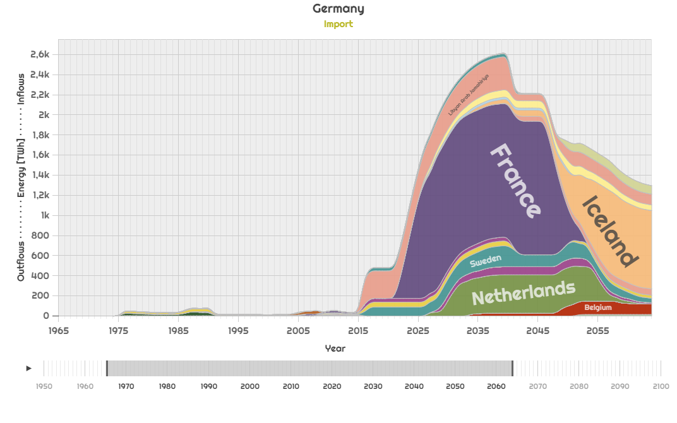
regional results
Notes:
Wealthy countries could afford to do that because of fossil fuels. 2 problems with that. Depletion and global warming.

Slide 39
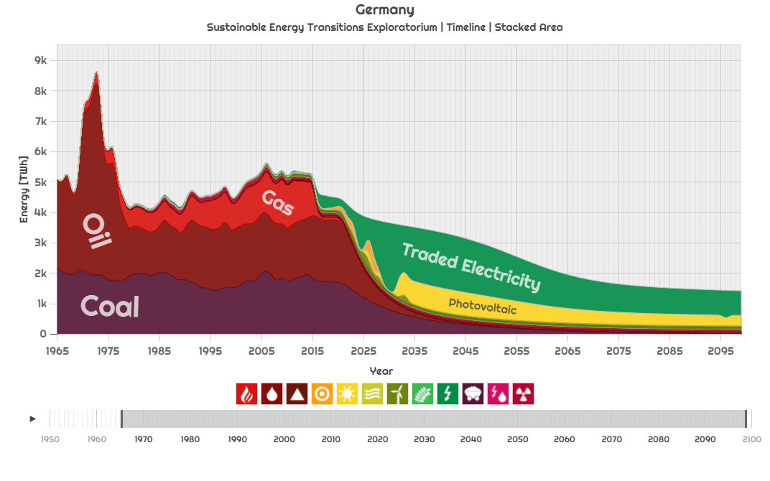
regional results
Notes:
Wealthy countries could afford to do that because of fossil fuels. 2 problems with that. Depletion and global warming.

Slide 40
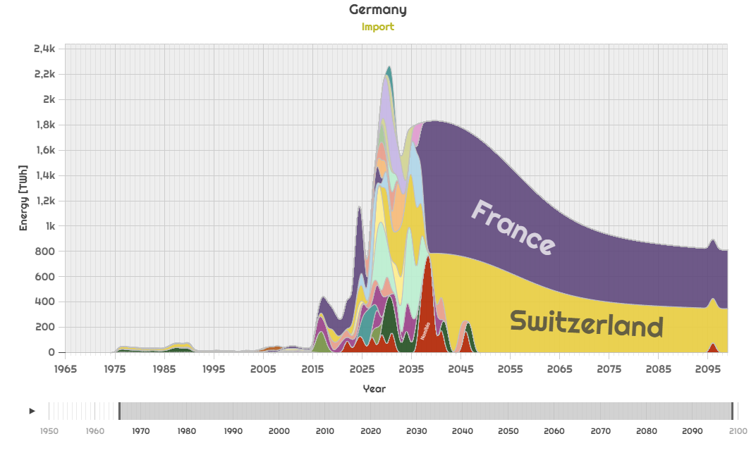
regional results
Notes:
Wealthy countries could afford to do that because of fossil fuels. 2 problems with that. Depletion and global warming.

Slide 41
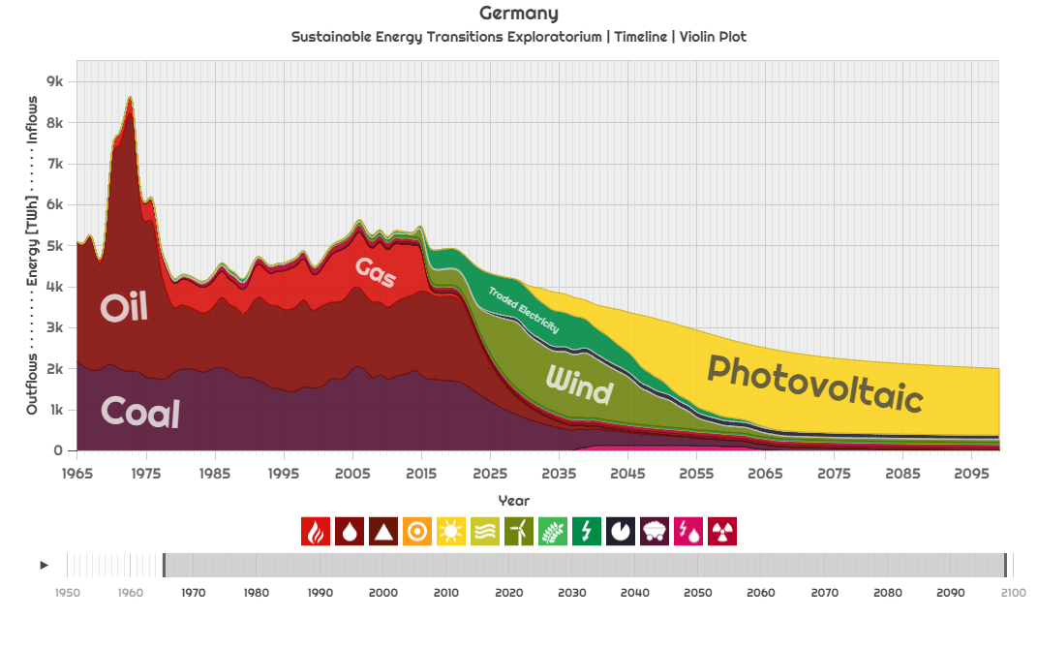
regional results
Notes:
Wealthy countries could afford to do that because of fossil fuels. 2 problems with that. Depletion and global warming.

Slide 42
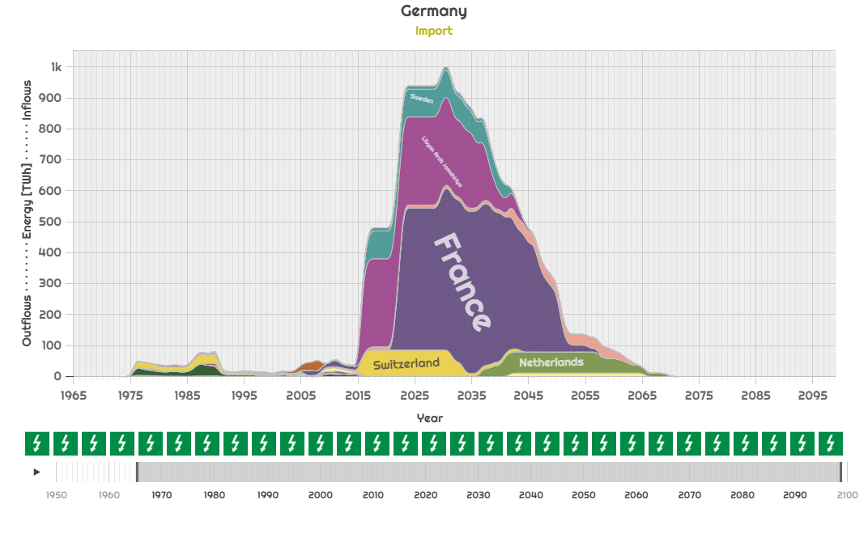
regional results
Notes:
Wealthy countries could afford to do that because of fossil fuels. 2 problems with that. Depletion and global warming.

Slide 43
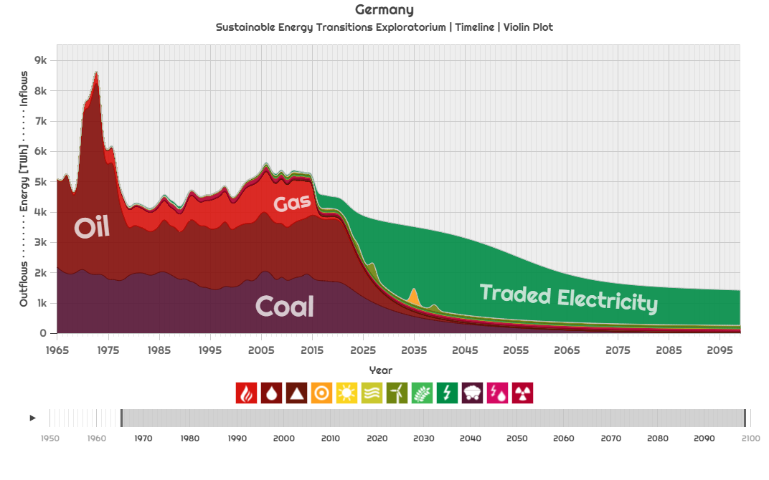
regional results
Notes:
Wealthy countries could afford to do that because of fossil fuels. 2 problems with that. Depletion and global warming.

Slide 44
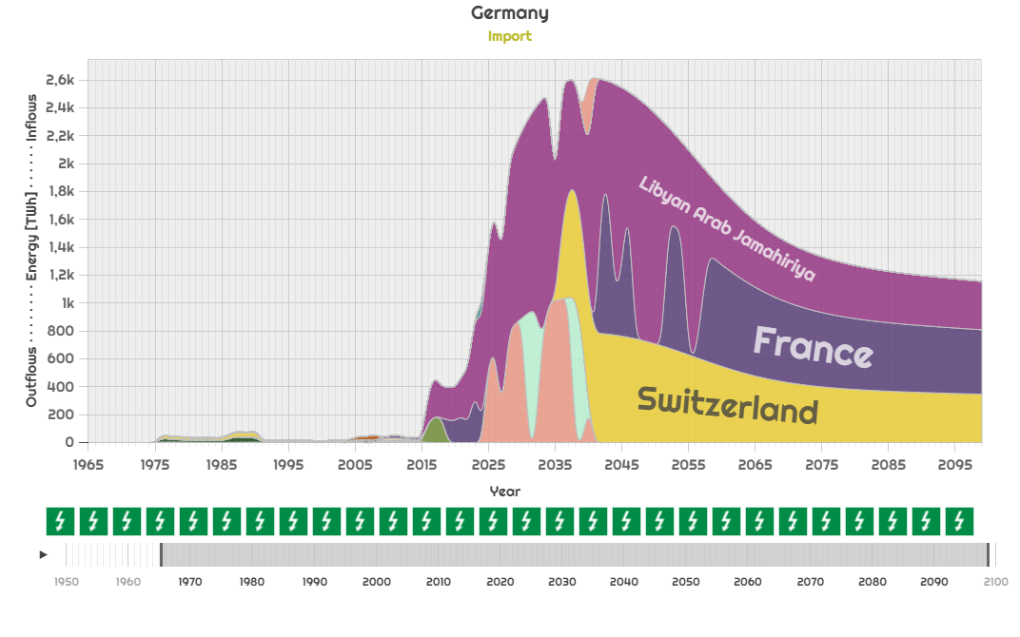
regional results
Notes:
Wealthy countries could afford to do that because of fossil fuels. 2 problems with that. Depletion and global warming.

Slide 45
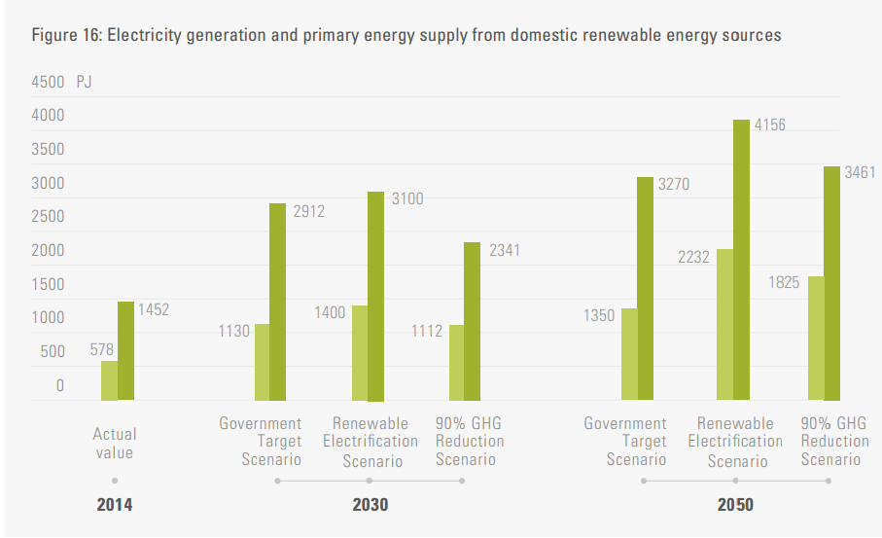
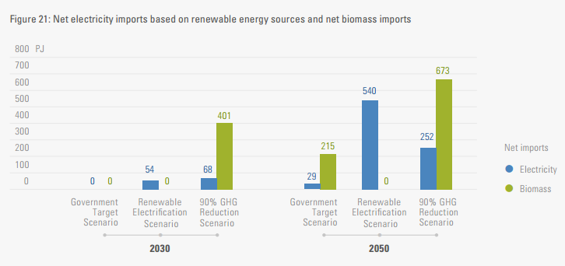
DDPP (2016)
Notes:
Garrett Hardin

Slide 46
results
Regional model without trade yields 106% if the investment of the global SET
Regional model with trade yields 85% if the investment of the global SET
global model did not have a direct adjustment for fuels-witching
default scenario demand: 2000W per capita in 2100.
average power demand in the regional case 3954W in 2100, with an average savings from fuel switching of -30.5%.
Forced shares of 0.4 solar 0.3 wind 0.1 concentrated solar
Adjusted: no trade 77% of global transition energy cost, with trade 62%
Notes:
Wealthy countries could afford to do that because of fossil fuels. 2 problems with that. Depletion and global warming.

Slide 47
conclusions & future work
This dissertation lays the theoretical foundations of the SET and provides a set of tangible guidelines for societies to follow to complete a SET, an alternative to existing economics-based IAMs that cannot model transitions
Developed a global model for SET and performed a sensitivity analysis over a wide range resource and demand parameters estimates for different CO₂ caps
Found that a global SET is possible, but early action is critical
Developed national energy transition pathways using physical energy balances while accounting for trade between regions
Found that coordinating trade can reduce the total costs of transition by 38%
Notes:
Wealthy countries could afford to do that because of fossil fuels. 2 problems with that. Depletion and global warming.

Slide 48
conclusions & future work
If adopted by policy makers, our methodology can yield optimal energy transition policies for countries and the world, while assuring that the emissions fit into predefined limits, unlike the current INDC approach
We developing the network model further to investigate different policy scenarios of individual countries under defect or collaborate regimes in adhering to a global cap
Our approach is a cost-effective in terms of human resource requirements when compared to other, concerted similar approaches, such as the Deep Decarbonization Pathways Project.
Notes:
Wealthy countries could afford to do that because of fossil fuels. 2 problems with that. Depletion and global warming.

Slide 49

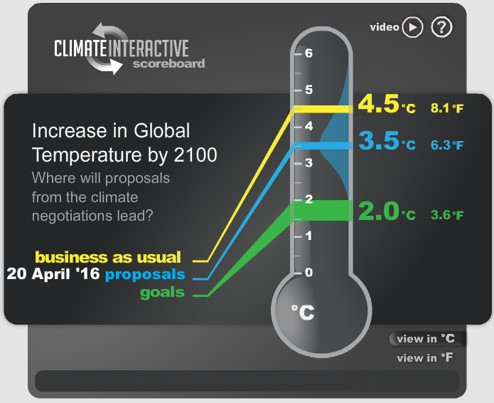
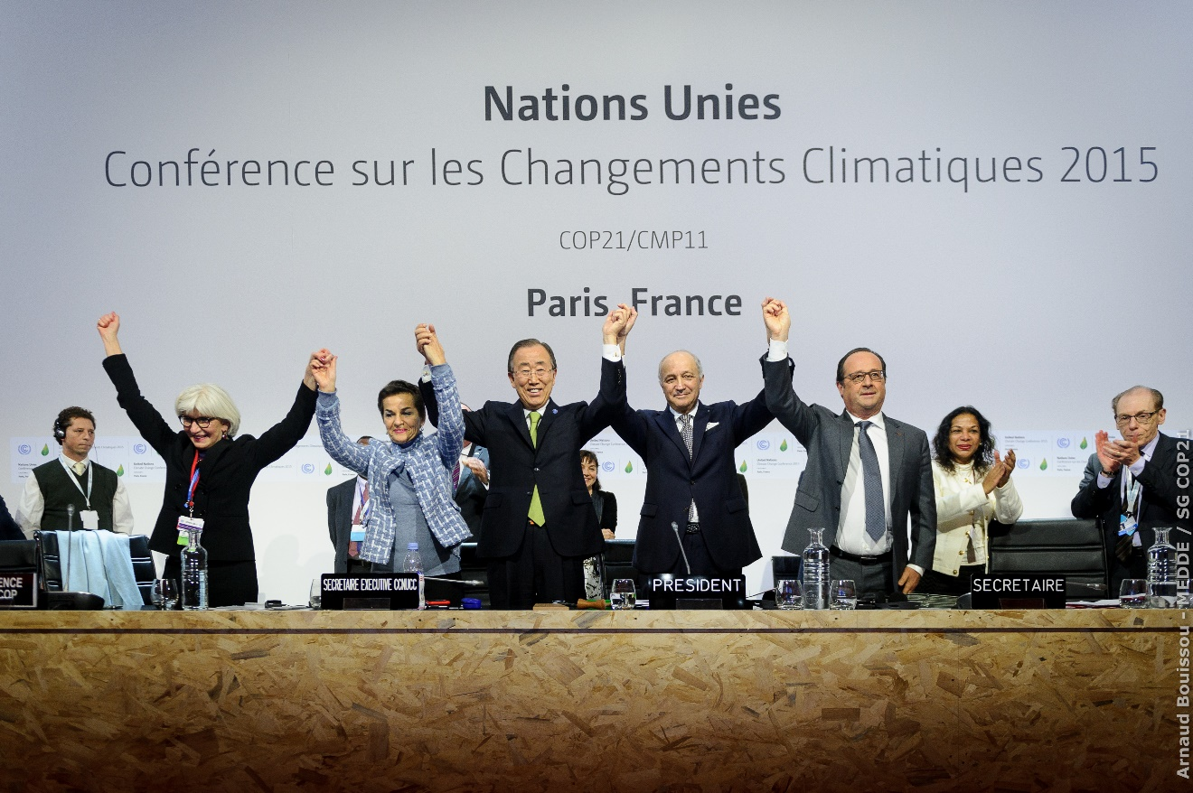
Climate Interactive (2016), image source: Huffington Post
Notes:
Garrett Hardin

Slide 50
thank you
Dénes Csala
PhD Defense
Masdar Institute | 12/05/16
A data-driven dynamic net-energy analysis of global and national sustainable energy transition paths

